Slide 1
Disclosure Title: Generative AI based Multi - Agent framework to automate SDLC lifecycle
Inventors:
Saigeetha A Jagannathan/India/IBM
Sridhar Jonnala/India/IBM
Isha Isha/India/IBM
mahirjain04@gmail.com
Vinay Kalmoodkar/India/IBM

Slide 2
Contents
Background
Problem Statement
Need for new solution
Advantages
Terminologies
Novelty Claimed
Literature Survey
Summary of Invention
Core Idea
High level work flow
Description
Detailed Flowchart
Components
References
Appendix

Slide 3
Background – Problem Statement

Slide 4
Background – Need for a new solution

Slide 5
Background - Advantages
1. Enhanced Efficiency
- Accelerated processes by automating repetitive tasks.
- Reduced manual effort, allowing developers to focus on complex tasks.
2. Improved Accuracy
- Early detection and correction of errors.
- Consistent application of standards and best practices.
3. Cost Savings
- Lower labor costs due to reduced manual intervention.
- Optimized resource utilization during development and deployment.
4. Faster Time-to-Market
- Quick iterations and rapid delivery of new features.
- Continuous integration and deployment for swift updates.

Slide 6
Background - Advantages
5. Scalability
- Efficient management of large and complex projects.
- Adaptability to changing project requirements.
6. Better Decision Making
- Data-driven insights for informed decisions.
- Predictive analytics to proactively address potential issues.
7. Increased Collaboration
- Enhanced communication with real-time updates and insights.
- Unified platform for seamless collaboration across SDLC stages.
8. Higher Quality Products
- Proactive issue resolution for a higher quality end product.
- Comprehensive automated testing for reliable software.
9. Continuous Improvement
- AI agents learn from past projects for ongoing enhancements.
- Adaptive systems that stay current with new technologies and practices.

Slide 7
Background - Terminologies

Slide 8
Novelty Claimed
The claims of Novelty for the solution described in this document are for the following processes/methods
Intra and Inter agents to automate individual components and overall SDLC processes
Define the types of agents
Master (Dynamic resource allocation, Decision support), Verification, Correction, feedback, latency check, anamoly detection agents, code review, testing, personlized user experience, expert agent (answer any query on the process)
Define hierarchial structure of the agents and functions of individual agents
Self evaluation of the agents and framework

Slide 9
Reference 1:
Literature Survey
This invention (Novelty) | Reference
Reference 2:
This invention (Novelty) | Reference
* Differentiating factors of this invention and the reference are highlighted
Notes:
https://arxiv.org/pdf/1605.01189.pdf

Slide 10
Summary - Core Idea & Method
Core idea:The integration of AI agents into the Software Development Life Cycle (SDLC) introduces several innovative approaches and technologies that significantly transform traditional development practices. Here’s how AI brings novelty to each phase of the SDLC:
Steps
Requirement Gathering and Analysis
Smart Requirement Extraction: AI agents utilize advanced natural language processing (NLP) techniques to extract and interpret requirements from unstructured data sources such as emails, meeting notes, and conversations. This reduces the risk of miscommunication and ensures a more accurate understanding of stakeholder needs.
Sentiment Analysis: AI can analyze stakeholder feedback and sentiment, providing deeper insights into user expectations and priorities.
Design
Adaptive Design Tools: AI-driven design tools can learn from previous projects and automatically adapt design templates and models, offering more personalized and efficient design solutions.
Predictive Modeling: Machine learning algorithms predict potential design flaws and performance bottlenecks early in the design phase, allowing for proactive adjustments.

Slide 11
Summary - Core Idea & Method
3. Implementation (Coding)
AI-Powered Code Suggestions: Intelligent code completion and suggestions based on contextual understanding of the codebase and project requirements, significantly speeding up the coding process.
Self-Learning Code Generation: AI models that continuously learn from existing codebases to improve their code generation capabilities, creating more accurate and efficient code over time.
4. Testing
AI-Driven Test Case Prioritization: Machine learning models prioritize test cases based on risk and impact, ensuring critical functionalities are tested first.
Automated Bug Detection: AI agents continuously monitor code changes and detect potential bugs and vulnerabilities in real-time, reducing the time and effort required for manual testing.
5. Deployment
Dynamic Resource Allocation: AI optimizes resource allocation during deployment, ensuring efficient use of computing resources and reducing costs.
Automated Rollback and Recovery: In case of deployment failures, AI agents can automatically roll back to previous stable versions and initiate recovery processes, minimizing downtime.
6. Maintenance
Anomaly Detection: AI continuously monitors application performance and detects anomalies, predicting potential issues before they impact the user experience.
Automated Updates: AI agents manage and apply software updates automatically, ensuring systems remain up-to-date with minimal manual intervention.

Slide 12
Summary - Core Idea & Method
7. Self-Evaluation of AI Agents
Assessing Performance Metrics
Evaluating Learning and Adaptation
Conducting Error Analysis
Gathering and Implementing User Feedback
Ensuring Ethical Compliance
Performing Robustness Testing
Analyzing Usability and Interaction
Maintaining Security and Privacy
Reviewing Maintenance and Updates
Benchmarking Against Industry Standards

Slide 13
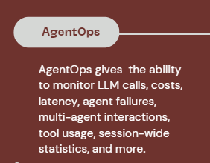
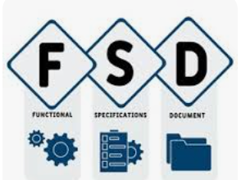









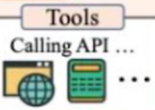







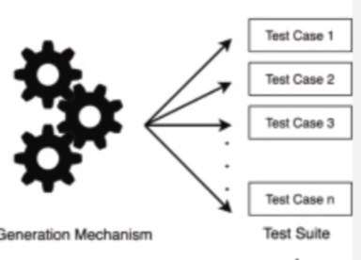

Summary: High Level Process flow
Incomplete Requirements
Requirement Analyzer Agent along with Human Input
Verification
Validation ,Correction
custom Tools
Tech Spec Generator
Auto Story FS
TSD
Validation Failed
SDLC Orchestrator Task Distribution
Monitoring and Performance Tuning
Bug Fixing
Updating and Enhancing Software
Documentation
Support and User Assistance
Security Management
Backup and Recovery
Compliance and Audits
Change Management
.Performance Metrics and Reporting
Agent Identifying
Test Scenarios
Test Case Generator Agent
Test Case Validator Agent
Test Case Execution Agent
Module Generation
Modular Code Generation
Code Merging
Performance Improvement
Code Review
Documentation
Notes:
Dm -Decision maker

Slide 14
Documentation
Agents
Requirements Analysis User Stories FSD,TSD
SDLC Agent Types
Development Agents
Code Generation Code Review Bug Detection
Project Development Agent
Testcase Generation Testcase Validation Testcase Execution
Feedback And Improvement Agent
QA Agents
SDLC Orchestrator
Maintenance Agents
System Performance, Availability, Health
Compliance & Risk Management Agent
Knowledge Expert Agent
Personalized user experience

Slide 15
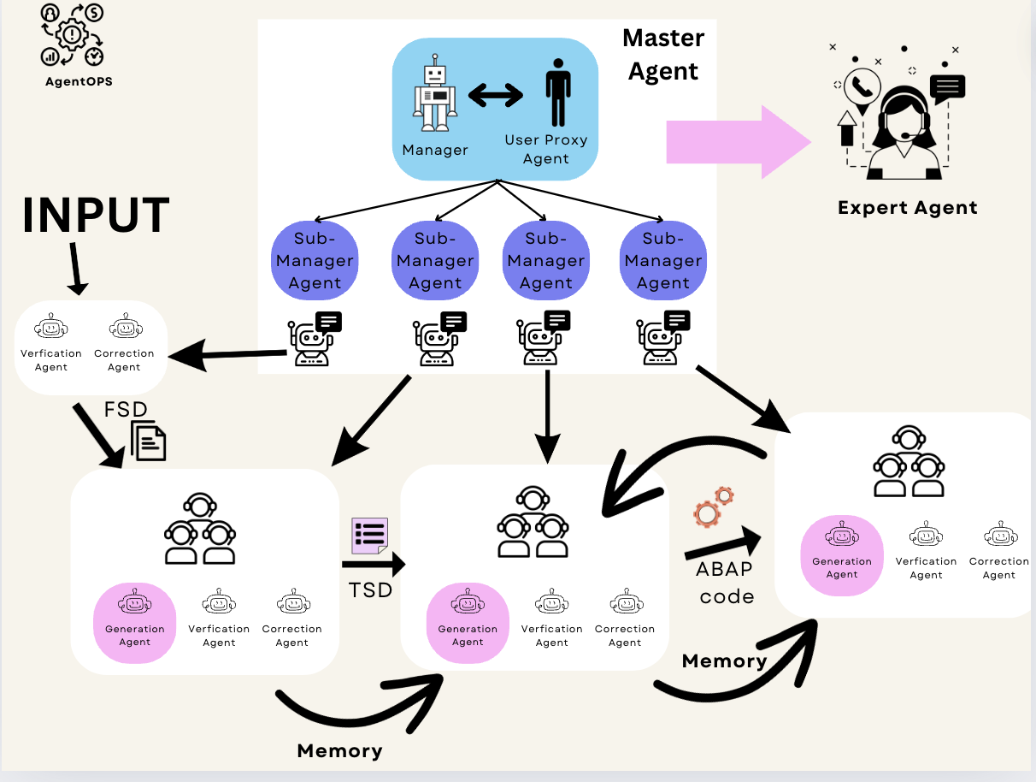
Individual component description
Notes:
Dm -Decision maker

Slide 16
AGENT BASED ARCHITECTURE
Agent: An agent is an entity that can send messages, receive messages and generate a reply using models, tools, human inputs or a mixture of them.
An agent-based model (ABM) is a simulation of something constructed from components, agents, which decide how to act independently from each other within some environment.
We propose an agent based model to automate the SDLC, comprising of multiple complex agents communicating with each other and completing individual tasks. There are six types of agents involved:
Master Agent - This controls all the agents and ensures harmonious interaction between them. It also ensures the proper flow of pipeline.
Generative/ Developer Agent - Agent generates or developes a very initial output based on the input, generally using APIs or functions.
Validation Agent - This agent is responsible for validating the output produced in the previous step.
Correction Agent - This agent on the basis of validation checks, corrects and reconstructs the output.
Feedback Agent - On the basis of future steps, and processes, the feedback agent tries an agentic way of training itself. The approach enhances the agents’ abilities without requiring access to the LLMs parameters.
Expert Agent - This agent is responsible for dealing with the user queries. Interacts with user to identify the flow of pipeline.
:

Slide 17
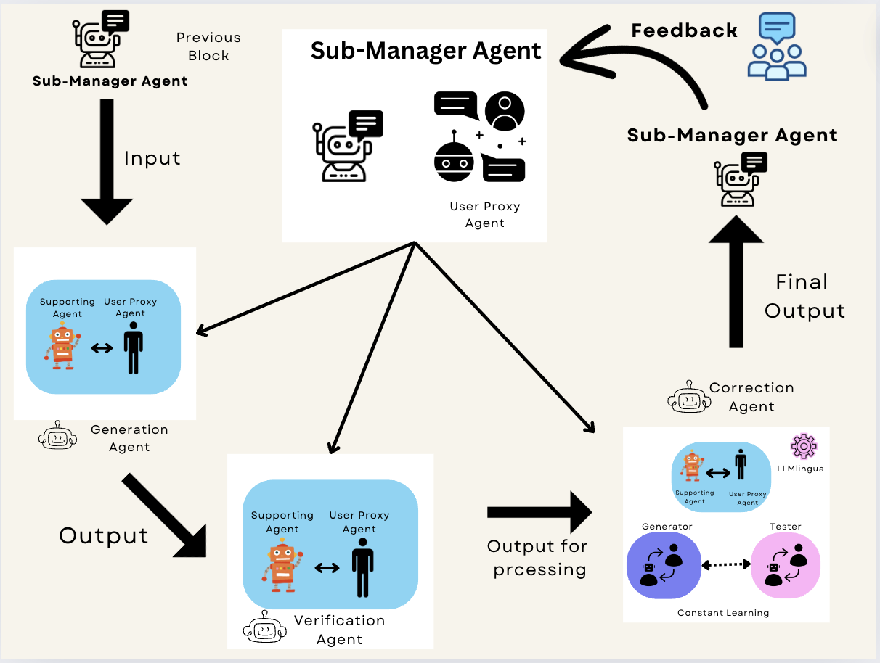

Slide 18
Master Agent
A Master Agent oversees the entire pipeline flow, managing both intra and inter agents, and connects with the Expert Agent to provide answers to user queries. This Master Agent comprises four Sub-Manager Agents, which communicate continuously in a group chat to stay updated on each other's tasks.
Each Sub-Manager Agent is responsible for deciding when to activate one of three subordinate agents:
1. Developer Agent (intra-agent)
2. Verification Agent (inter-agent)
3. Correction Agent (inter-agent)
Since the subordinate agents remain same, the Sub Manager Agent ensures that these agents work for the appropriate process in the lifecycle.
The Sub-Manager Agent ensures effective communication between these agents and extracts relevant information from the previous steps by consulting the preceding Sub-Manager Agent. It uses this additional information to enhance the current process.
For instance, when the Technical Specification Document (TSD) is generated, verified, and corrected, the Sub-Manager Agent ensures that the agents also have access to the Functional Specification Document (FSD) that initially produced the TSD. This ensures that the agents can perform their tasks more effectively.

Slide 19
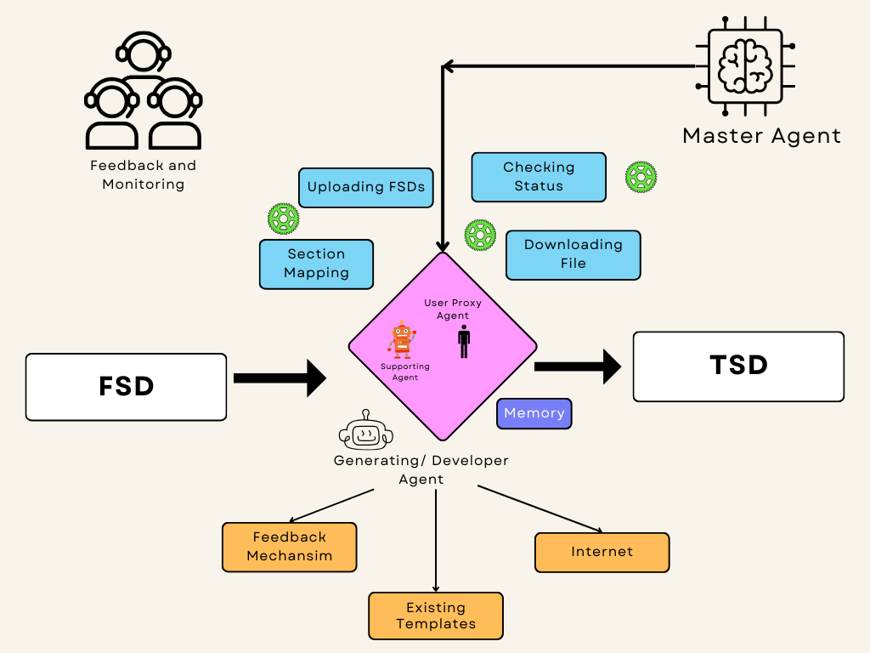

Slide 20
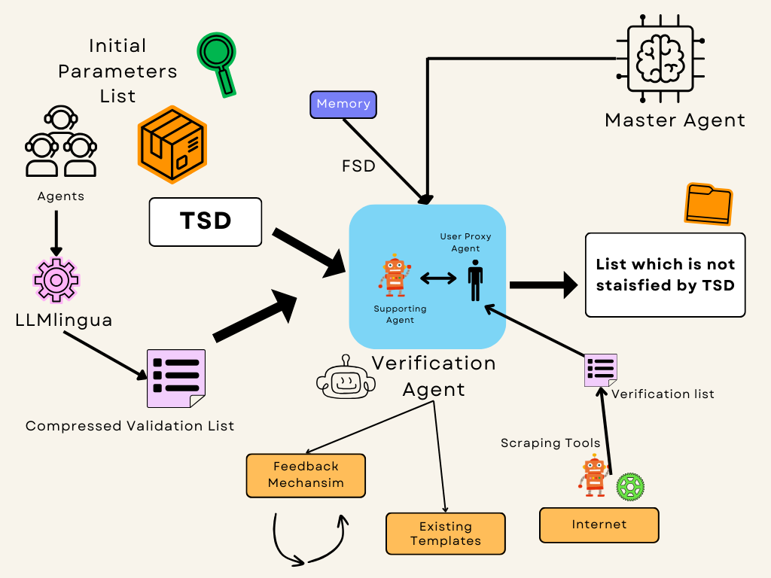

Slide 21
Generative/ Developer Agent
Developer Agent, is an Inter Agent, it automates the process of creating or generating the initial output from the given input.
This agent utilizes multiple tools under its belt, to make the development more efficient, and producing better outputs.
Its functionalities are -
Accesses the web to send GET and POST requests required for the generation process.
Uses a feedback agent that helps the agent to generate the most optimal output.
Verification Agent
Verification Agent, is an Intra Agent, it automates the process of validating or checking the generated initial output from the given list of parameters by the user or by scraping the internet.
Its functionalities are -
Generates a list of parameters thats were not fulfilled by the generated initial output.
Uses existing templates and feedback to revise and generate a new list of validation checks.

Slide 22
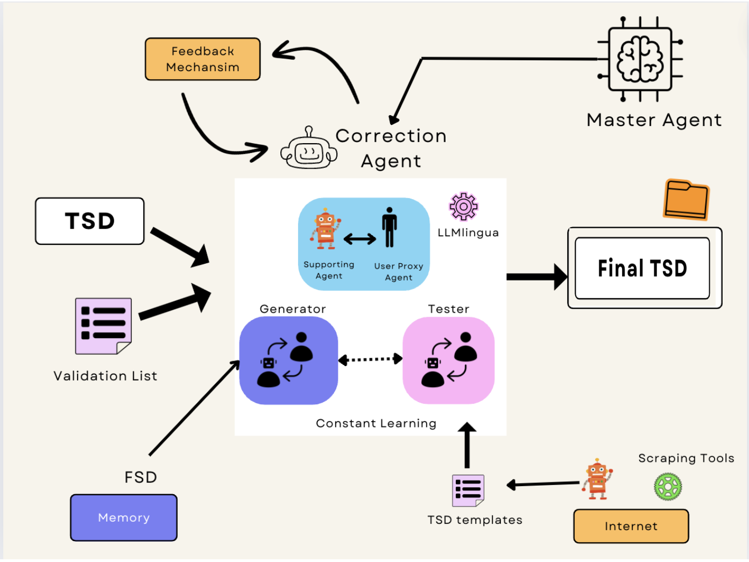

Slide 23
Correction Agent
Correction Agent, is an Inter Agent. It has a discriminator - generator type architeture. Within the Correction agent, there’s a User Proxy, A generative and a testing agent.
User Proxy - It acts as human, and maintains the flow of information between the generative and testing agent.
Generative Agent - Based on the validation checks provided by Validation Agent, it reconstructs the final output.
Testing Agent - It again checks/verifies the output by Generative Agent, and is only passed forward until it is satisfied.
The Generative Agent attempts to satisfy the Testing Agent, which is tasked with accurately validating the Output. Realistic, high-quality output are produced as a result of this competitive interaction, which drives the overall agent toward advancement.
Expert Agent
Expert Agent, is an Intra Agent. Interacts with the User to answer all the queries related to the pipeline. It keeps track of the execution of pipeline steps. It provides real-time updates and responds to user queries about the current step being executed and the time taken for each step.
It is also connected with AgentOps, keeping track of the tokens used by each agent, and latency reports of each subprocess in the pipeline. It gives the user the ability to monitor LLM calls, agent failures, tool usage, session-wide statistics, and more.

Slide 24
References

Slide 25
Thanks

